Slide 1

Lesson 2: Basics

Slide 2
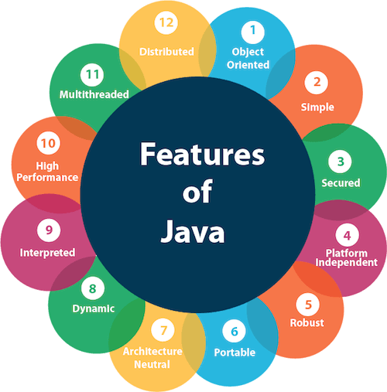
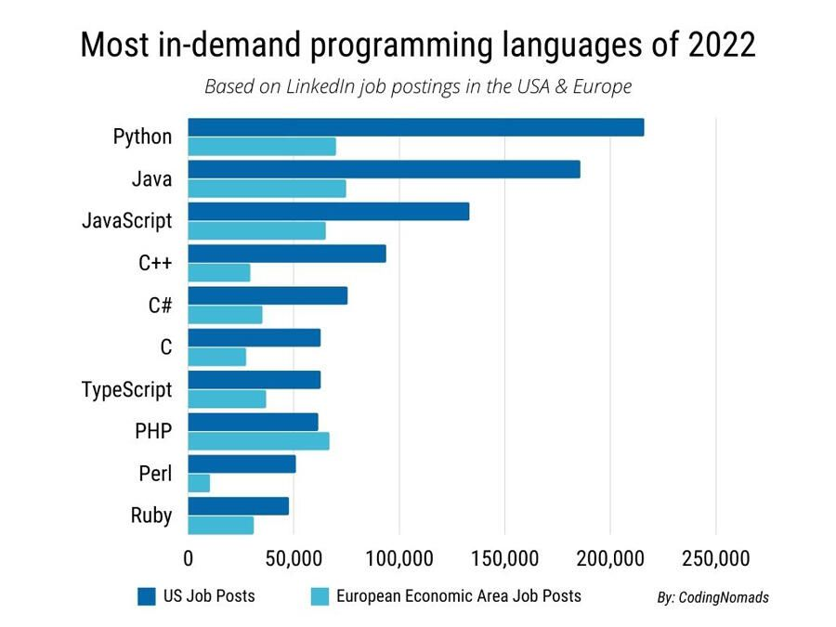
Why JAVA?

Slide 3
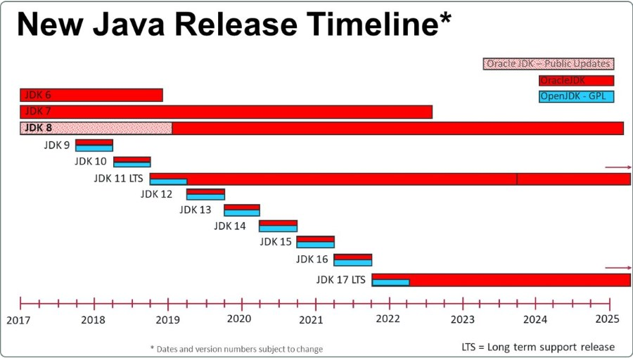
Java Timeline

Slide 4
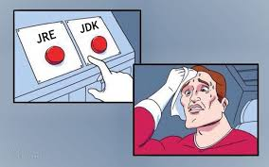
JDK vs JVM vs JRE
JVM(Java Virtual Machine) - specification that provides runtime environment in which java bytecode can be executed
JRE(Java Runtime Environment) = JVM + Library Files. It is the implementation of JVM.
JDK(Java Development Kit) contains set of libraries + other files that JVM uses at runtime.

Slide 5
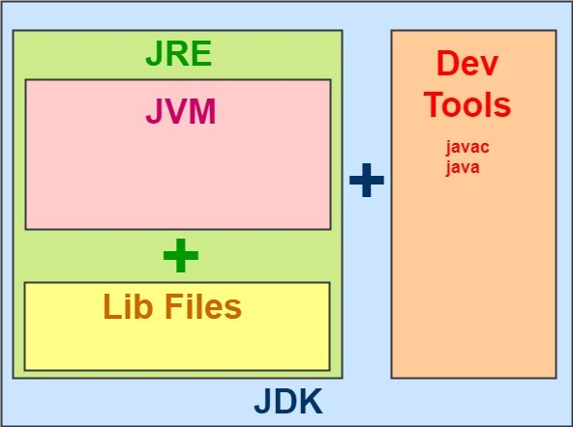

Slide 6
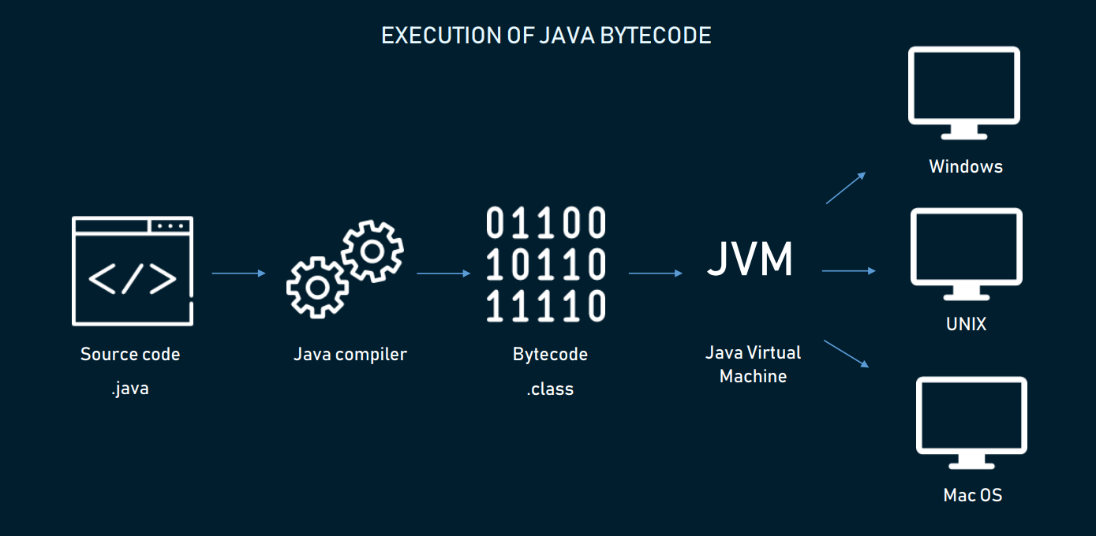
WORA – Write Once Run Anywhere

Slide 7
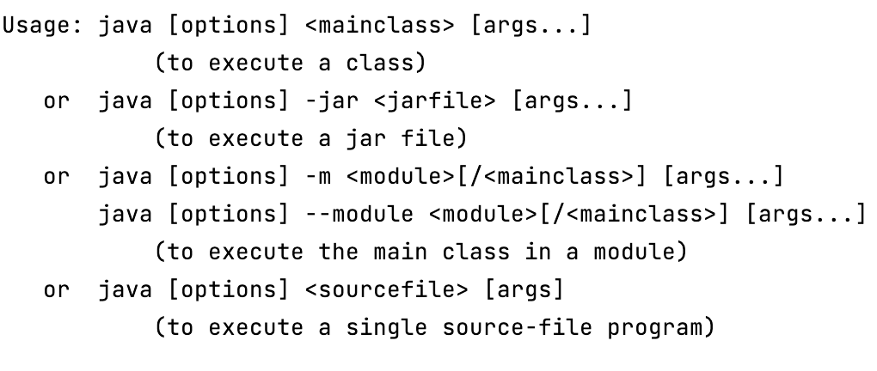
How to run your Java program?

Slide 8
Java syntax overview
Case Sensitivity − Java is case sensitive, which means identifier Hello and hello would have different meaning in Java.
Class Names − For all class names the first letter should be in Upper Case. If several words are used to form a name of the class, each inner word's first letter should be in Upper Case.
Method Names − All method names should start with a Lower Case letter. If several words are used to form the name of the method, then each inner word's first letter should be in Upper Case.
public static void main(String args[]) − Java program processing starts from the main() method which is a mandatory part of every Java program.
Identifiers must be composed of letters, numbers, the underscore _ and the dollar sign $. Identifiers may only begin with a letter, the underscore or a dollar sign.
Every statement ends with “;”
Code blocks are inside {} brackets
Whitespace, tab and line breaks are only for formatting but (formatting is very important!)
Comments: //Comment, /* Comment */

Slide 9
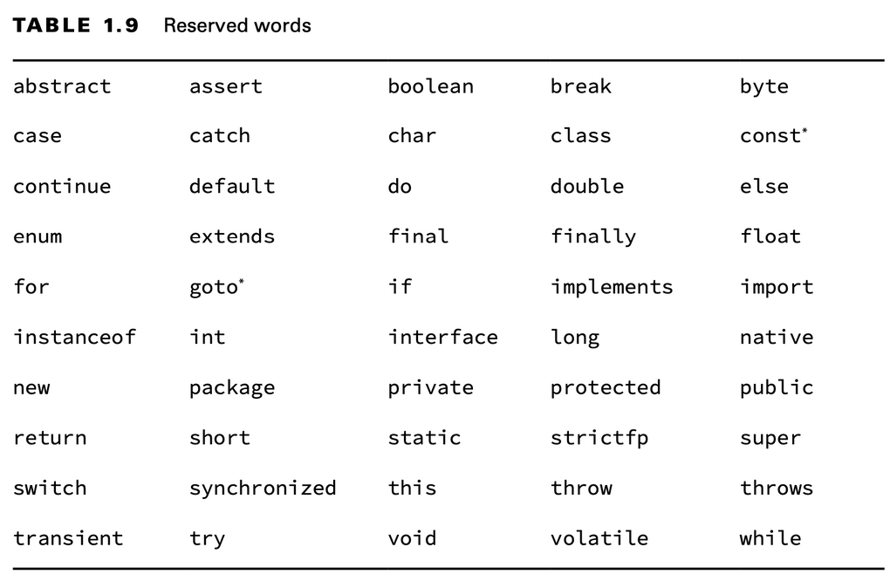
Reserved words

Slide 10
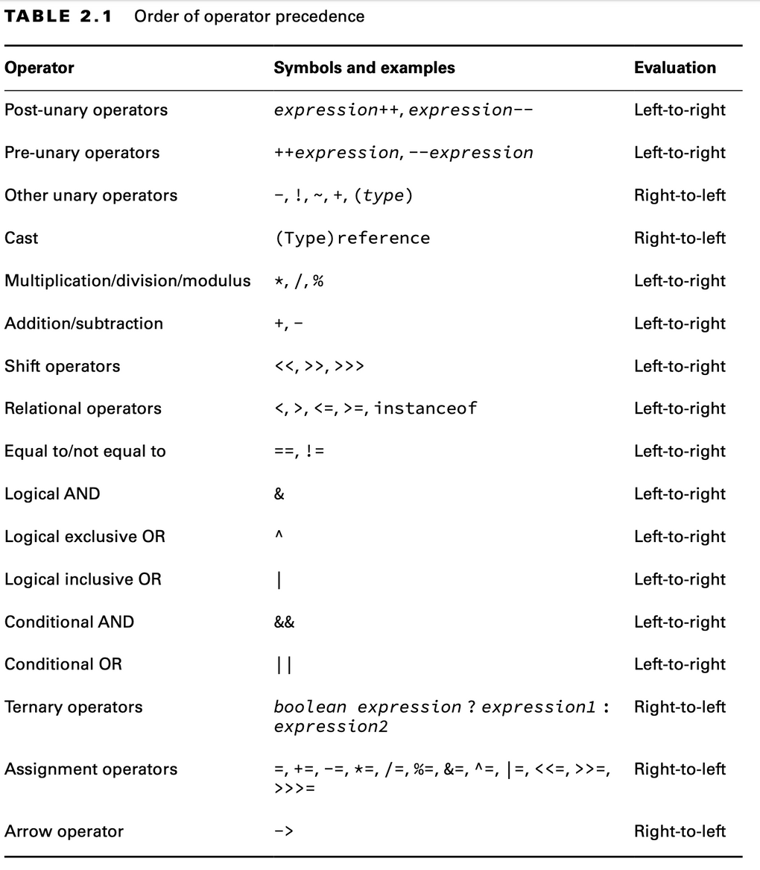
Operators and order

Slide 11
Numeric promotion rules
If two values have different data types, Java will automatically promote one of the values to the larger of the two data types.
If one of the values is integral and the other is floating-point, Java will automatically promote the integral value to the floating-point value’s data type.
Smaller data types, namely, byte, short, and char, are first promoted to int any time they’re used with a Java binary arithmetic operator with a variable (as opposed to a value), even if neither of the operands is int.
After all promotion has occurred and the operands have the same data type, the resulting value will have the same data type as its promoted operands.

Slide 12
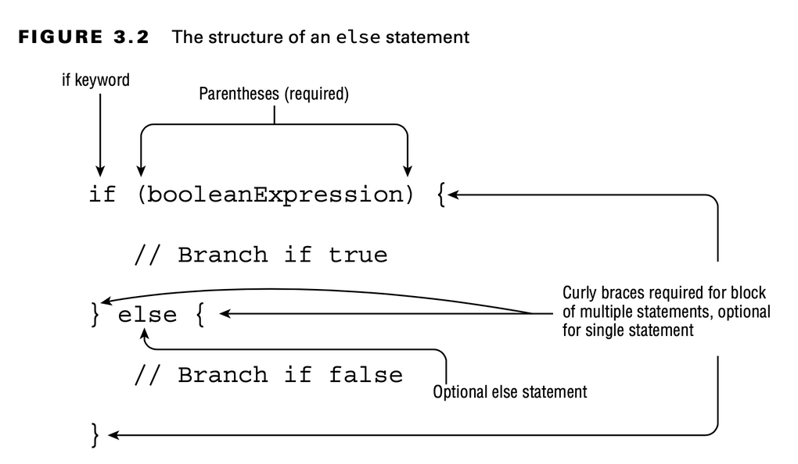
Conditional operator if else
int n = readNumber(); if (n == 1) { System.out.println("1"); } else if (n == 2 || n == 3) { System.out.println("2 or 3"); } else { System.out.println("4"); }

Slide 13
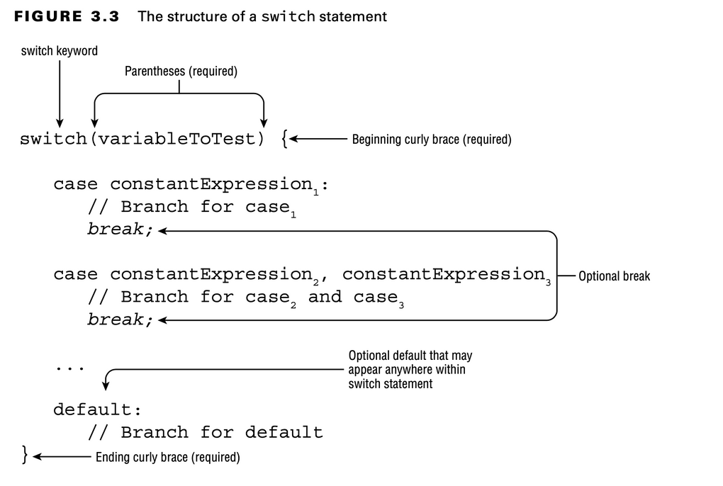
Conditional operator switch
int n = readNumber(); switch (n) { case 1: System.out.println("1"); break; case 2: case 3: System.out.println("2 or 3"); break; default 4: System.out.println("4"); }

Slide 14
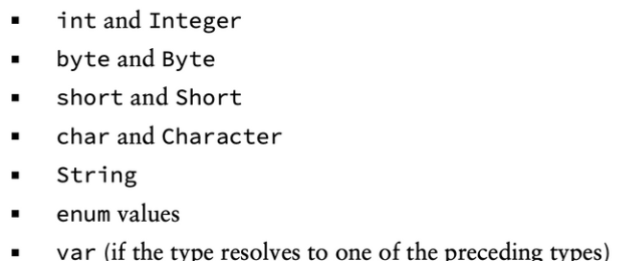
Data types supported by switch statemets

Slide 15
Loop while “do”
while (condition) { statement; }
int count = 0; while (count < 5) { System.out.println(count); count++; }

Slide 16
Loop “do” while
do { statement; } while (condition);
int count = 0; do { System.out.println(count); count++; } while (count < 5);

Slide 17
Conditional loop for
for (initialization; condition; increment){
statement;
}
for (int count = 0; count < 5; count++) { System.out.println(count); }

Slide 18
Branching statement break
int maxRetries = 10; for(int i = 0;;) { if(i > maxRetries){ break; // stop iteration and exit from the loop
} doSomething();
i++; }

Slide 19
Branching statement continue
for(int i = 0;; i++) { if(i % 5 == 0){
doSomethingAnother();
continue; // skip current iteration
} doSomething(); }

Slide 20
Branching statement return
for(int i = 0; i < 10; i++) { if(i > 5) { return -1; // stop iteration and exit from method } doSomething(); }
return result;

Slide 21
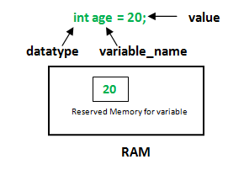
Variables
Local variables: In scope from declaration to the end of the block
Method parameters: In scope for the duration of the method
Instance variables: In scope from declaration until the object is eligible for garbage collection
Class variables: In scope from declaration until the program ends

Slide 22
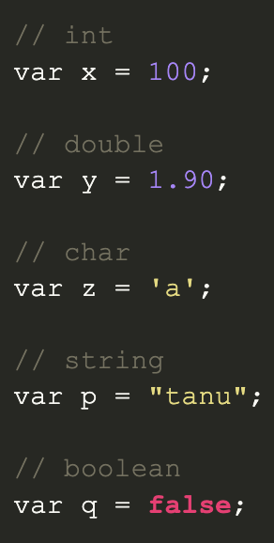
var keyword in Java
The var keyword was introduced in Java 10. Type inference is used in var keyword in which it detects automatically the datatype of a variable based on the surrounding context. The below examples explain where var is used and also where you can’t use it.
var rules and restrictions
We can declare any datatype with the var keyword.
var can be used in a local variable declaration.
var cannot be used in an instance variable declaration.
var cannot be used as a Generic type.
var cannot be used with the generic type.
var cannot be used without explicit initialization.
var cannot be used with Lambda Expression.
var cannot be used for method parameters and return type.

Slide 23
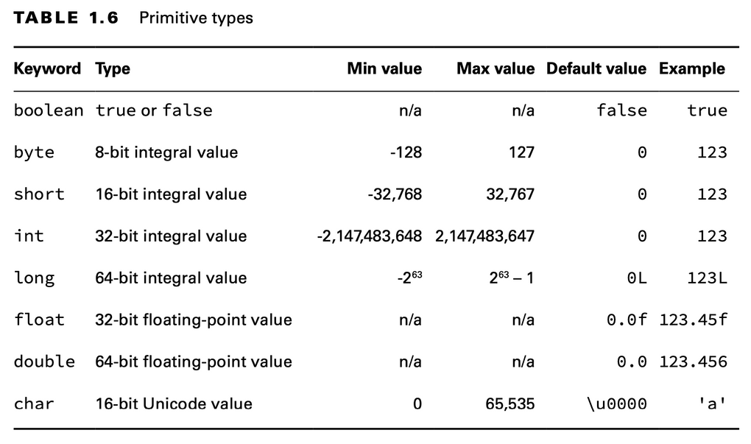
Primitive types

Slide 24

Primitive types overview
The byte, short, int, and long types are used for integer values without decimal points.
A float requires the letter f or F following the number so Java knows it is a float. Without an f or F, Java interprets a decimal value as a double.
A long requires the letter l or L following the number so Java knows it is a long. Without an l or L, Java interprets a number without a decimal point as an int in most scenarios.
You can add underscores anywhere except at the beginning of a literal, the end of a literal, right before a decimal point, or right after a decimal point. You can even place multiple underscore charac- ters next to each other, although we don’t recommend it.

Slide 25
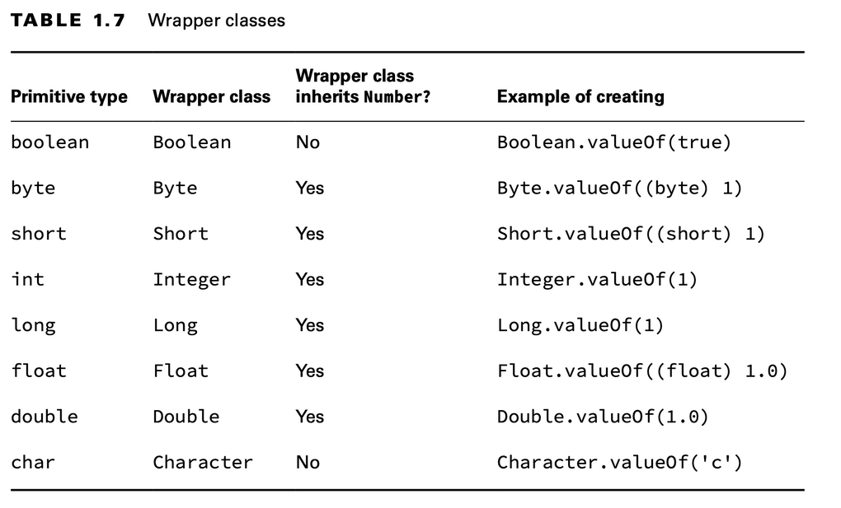
Class-wrappers

Slide 26
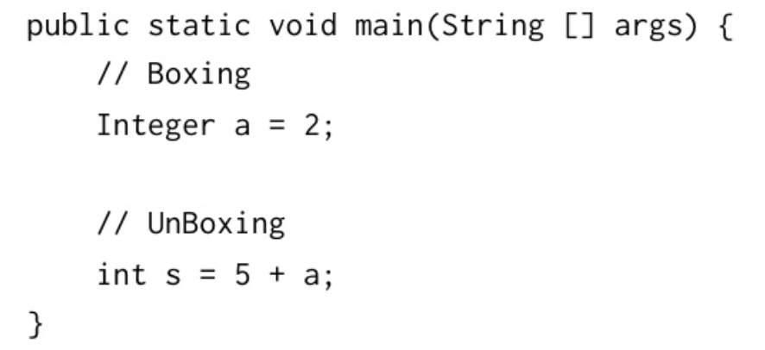
Here is an Autoboxing and Unboxing comes
Autoboxing is the automatic conversion that the Java compiler makes between the primitive types and their corresponding object wrapper classes. For example, converting an int to an Integer, a double to a Double, and so on. If the conversion goes the other way, this is called unboxing.

Slide 27
Performance problem with autoboxing
long startTime = System.currentTimeMillis(); Long sum = 0L; for (Long i = 0L; i < Integer.MAX_VALUE; i++) { sum += i; } System.out.println("total:" + sum); long executionTime = System.currentTimeMillis() - startTime; System.out.println("processing time: " + executionTime + " ms");

Slide 28
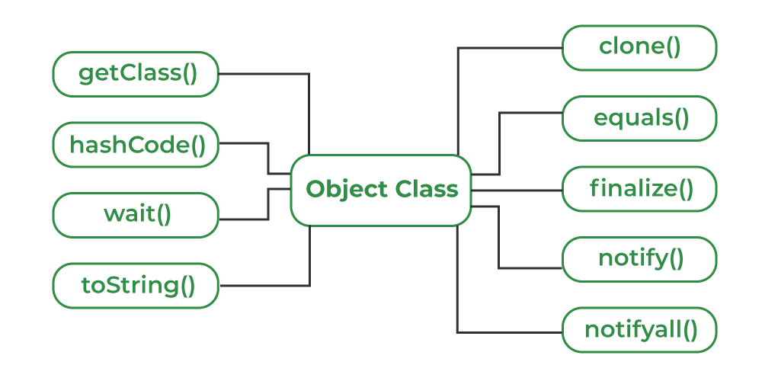
java.lang.Object
Every class in Java is directly or indirectly derived from the Object class.

Slide 29
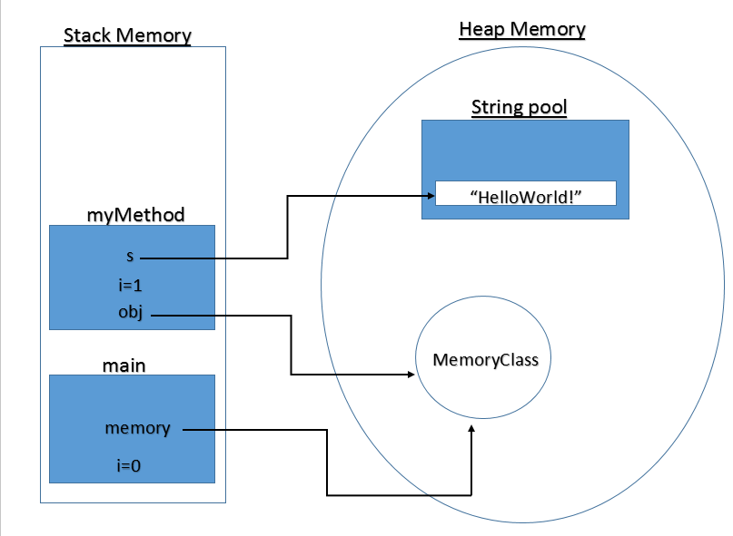
Let’s talk a little bit about memory

Slide 30
Stack Memory
Stack Memory in Java is used for static memory allocation and the execution of a thread. It contains primitive values that are specific to a method and references to objects referred from the method that are in a heap.
It grows and shrinks as new methods are called and returned, respectively.
Variables inside the stack exist only as long as the method that created them is running.
It's automatically allocated and deallocated when the method finishes execution.
If this memory is full, Java throws java.lang.StackOverFlowError.
Access to this memory is fast when compared to heap memory.
This memory is threadsafe, as each thread operates in its own stack.

Slide 31
Heap Memory
Heap space is used for the dynamic memory allocation of Java objects and JRE classes at runtime. New objects are always created in heap space, and the references to these objects are stored in stack memory.
These objects have global access and we can access them from anywhere in the application.
We can break this memory model down into smaller parts, called generations, which are:
Young Generation – this is where all new objects are allocated and aged. A minor Garbage collection occurs when this fills up.
Old or Tenured Generation – this is where long surviving objects are stored. When objects are stored in the Young Generation, a threshold for the object's age is set, and when that threshold is reached, the object is moved to the old generation.
Permanent Generation – this consists of JVM metadata for the runtime classes and application methods.

Slide 32
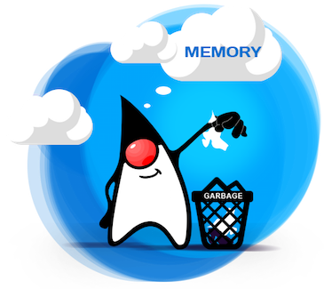
Garbarage Collector

Slide 33
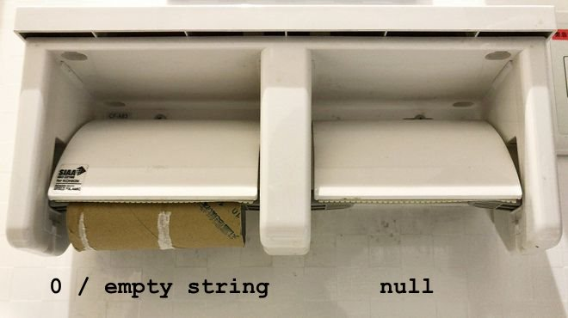
null vs 0
null means that a variable contains a reference to a space in memory that does not contain an object. 0 is a numeric data type with a value of 0.

Slide 34
java.lang.String
Data type String is used for storing sequence of Unicode characters.
String empty = "";
String emptyUsingConstructor = new String ();
String geekHub = new String (”GeekHub") ;
String season12 = ”Season12" ;
String concatMessage = ”super".concat(geekHub);
String plusMessage = ”super " + geekHub;

Slide 35
Useful methods of String class
int length(); boolean isBlank(); boolean equals(Object anObject); int indexOf(int ch);
String repeat(int count); String substring(int beginIndex, int endIndex); String concat(String str); boolean contains(CharSequence s); String replace(char oldChar, char newChar); String strip(); String[] split(String regex);
…

Slide 36
String is immutable!
An immutable object is an object whose internal state remains constant after it has been entirely created. This means that once the object has been assigned to a variable, we can neither update the reference nor mutate the internal state by any means.
The key benefits of keeping this class as immutable are caching, security, synchronization, and performance.
The String is the most widely used data structure. Caching the String literals and reusing them saves a lot of heap space because different String variables refer to the same object in the String pool. String intern pool serves exactly this purpose.
Java String Pool is the special memory region where Strings are stored by the JVM. Since Strings are immutable in Java, the JVM optimizes the amount of memory allocated for them by storing only one copy of each literal String in the pool. This process is called interning.

Slide 37
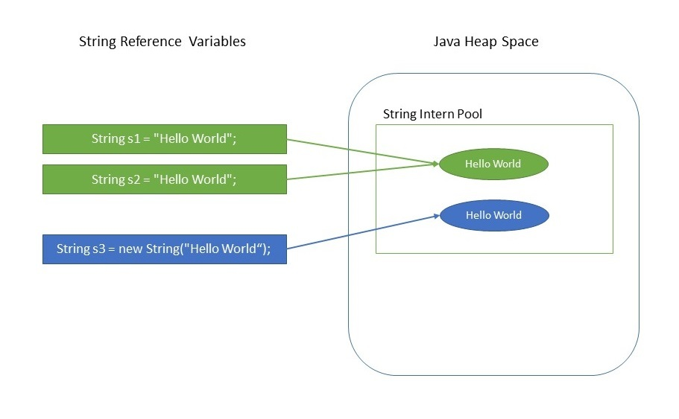
String Pool

Slide 38
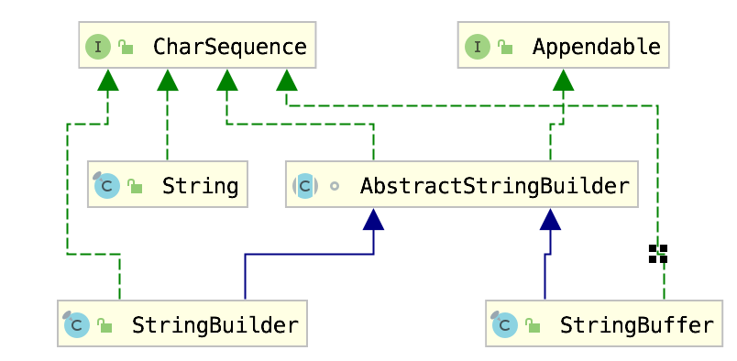
String vs StringBuilder vs StringBuffer
Since String is immutable in Java, whenever we do String manipulation like concatenation, substring, etc. it generates a new String and discards the older String for garbage collection. These are heavy operations and generate a lot of garbage in heap. So Java has provided StringBuffer and StringBuilder classes that should be used for String manipulation. StringBuffer and StringBuilder are mutable objects in Java. They provide append(), insert(), delete(), and substring() methods for String manipulation.

Slide 39
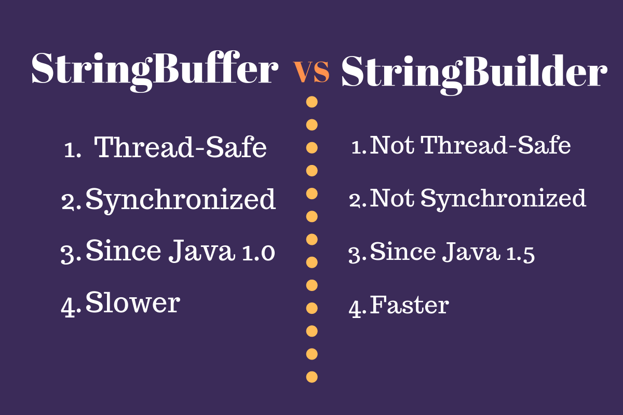

Slide 40
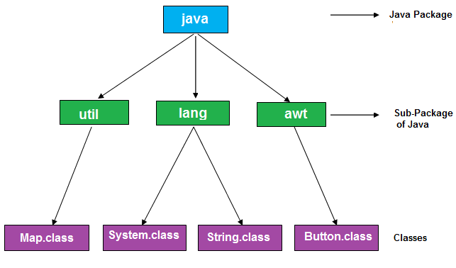
Packages

Slide 41
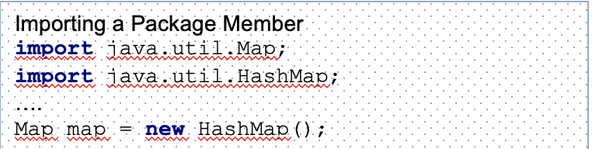
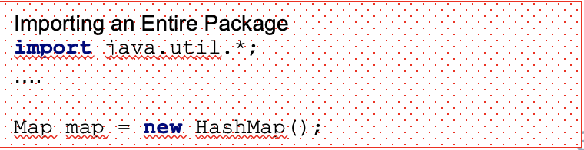
Imports
import <package.name>.<classname>;
Reverse domain name convention
java.lang is imported by default

Slide 42
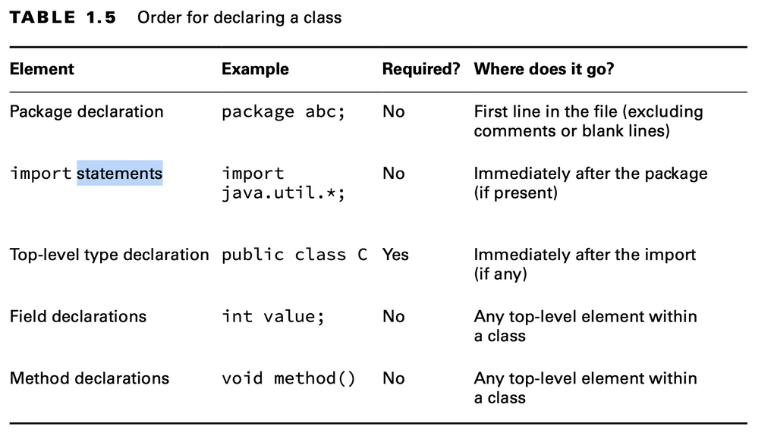
Class structure

Slide 43
java.lang.Math
public static double sin(double a)
public static double cos(double a)
public static double exp(double a)
public static double sqrt(double a)
public static double pow(double a, double b)
public static int round(float a)
public static int abs(int a)
public static int max(int a, int b)
public static int min(int a, int b)
…

Slide 44
java.lang.System
System.out.printf("Hello World!")
System.out.println("Hello World!")
System.currentTimeMillis()
System.exit(1)
System.getProperty("path.separator")
System.gc()

Slide 45
java.util.Scanner
Scanner scanner = new Scanner(System.in);
String string = scanner.next();
int count = scanner.nextInt();

Slide 46

Any questions?

Slide 47
Then I have a few questions for you

Slide 48
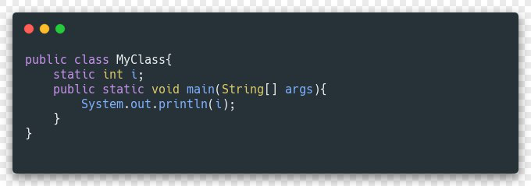
What will be printed after compile and run this code?
a) null b) 0 c) 1 d) runtime error

Slide 49
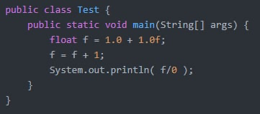
What will be printed after compile and run this code?
a) null b) 0 c) 3 d) cannot be compiled

Slide 50

What will be printed after compile and run this code?
a) 0 b) 2 c) 1 d) cannot be compiled

Slide 51
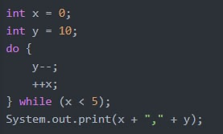
What will be printed after compile and run this code?
a) 4,6 b) 9,18,27,36,4 c) 9,1 d) 5,5

Slide 52
Literature
Java Basics:
Getting started
Language Basics
Classes and Objects
Auto boxing and Unboxing
Strings
Arrays
Memory model
Books:
“Clean Code” by Robert Martin (chapter 1-2)
“Java: The Complete Reference” by Herbert Schildt (chapter 2-6)

Slide 53
Homework
Write ‘calculate’ method which accepts integer N and returns double. If it divides by 2 then calculate square area with side of size N. If it divides by 3 then calculate circle area with radius N. Otherwise, calculate equilateral triangle area with side N. Order of checks matters. Return calculated area value. Commit your changes.
Please fetch snippet for homework from our repo: https://github.com/V-Nikolenko/GeekHub-J4W-12

Slide 54
Thanks!
Find us in Slack:
@Bohdan Cherniak
@Vladyslav Nikolenko
@Volodymyr Vedula

